Slide 1

Deep Learning

Slide 2
Examples
Recent Example in GO game
Examples in Marketing/Business

Slide 3
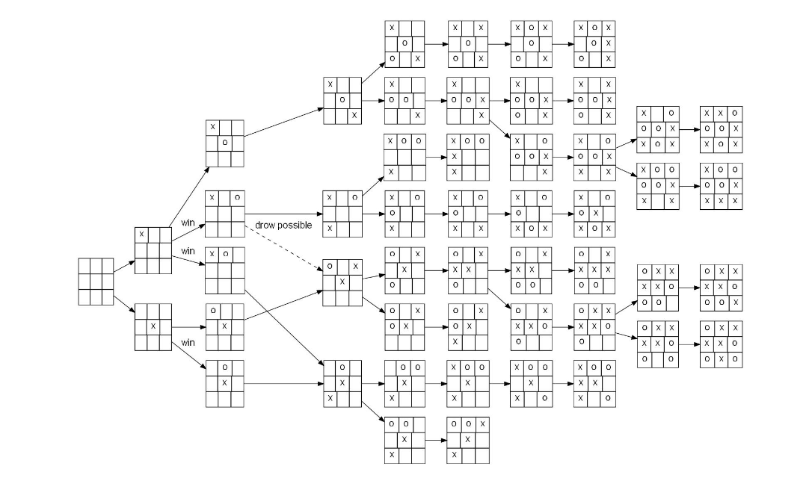
Deep Learning – Google AlphaGo Example
In 1997, Garry Kasparov was defeated by Deep Blue, a computer program written by IBM, running on a supercomputer.
For chess, the tree would contain 10¹²⁰ nodes, which seems impossible to store on a computer
Game tree: Tic-Tac-Toe
https://www.tastehit.com/blog/google-deepmind-alphago-how-it-works/

Slide 4

Deep Learning – Google AlphaGo Example
The total number of possible games of Go has been estimated at 10⁷⁶¹, compared to 10¹²⁰ for chess. Both are very large numbers: the entire universe is estimated to contain "only" about 10⁸⁰ atoms.
BBC Newsnight for your interest
How alphago Works…
1:05 to 2:00
4:30 to 5:30.

Slide 5
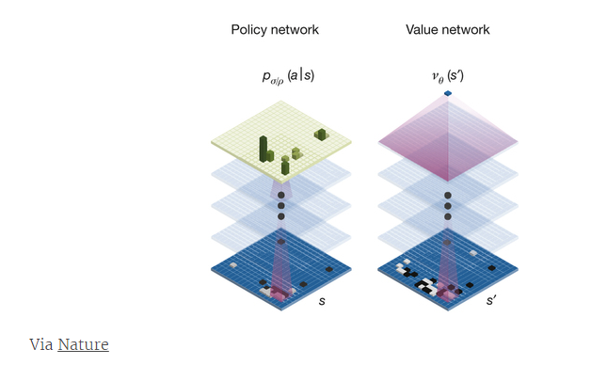
GO game is almost infinite number of nodes: So, people were very skeptical for AI’s winning human player.
Reinforcement Learning (dynamic programming in Economics and Industrial Engineering)
Convolutional Neural Network (one of Deep Learning methods): a sub-type of neural network that are especially well adapted for the processing of image data
More recently (2017), Deepmind introduced AlphaZero (without human knowledge – not using any data) see https://www.youtube.com/watch?v=Wujy7OzvdJk

Slide 6
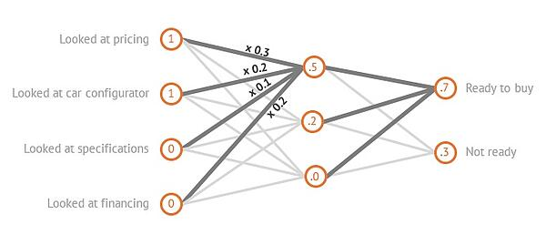
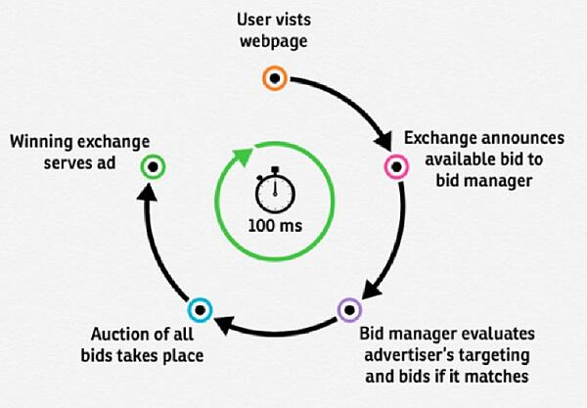
Deep learning application Example in Marketing
Real Time Bidding (RTB) Software for buying AD space ($23.5 B in the US)
When a user visits, an advertiser is alerted, and a series of actions determines whether or not that advertiser bids for an ad display.
The RTB use neural network to predict buying propensity (0 or 1).
https://blog.hubspot.com/marketing/what-is-deep-learning/

Slide 7
Sentiment classification of unstructured texts (Kim 2019, working paper)
Sentence Sentiment Classification Accuracy by Deep-learning Method (using Keras with TensorFlow in R)
Training sample data:
Positive label: sentences from 5-star ratings reviews,
Negative labels: sentences from 1-star rating reviews
A largest review site for rating professors: total 1,213,631 sentences.
A largest review site for rating reviews: total 8,938,587 sentences.
We need to prepare the converted numeric coding data from text data (https://machinelearningmastery.com/prepare-text-data-deep-learning-keras/)
https://blogs.rstudio.com/tensorflow/posts/2017-12-07-text-classification-with-keras/ (IMDB sentence sentiment classification example)

Slide 8
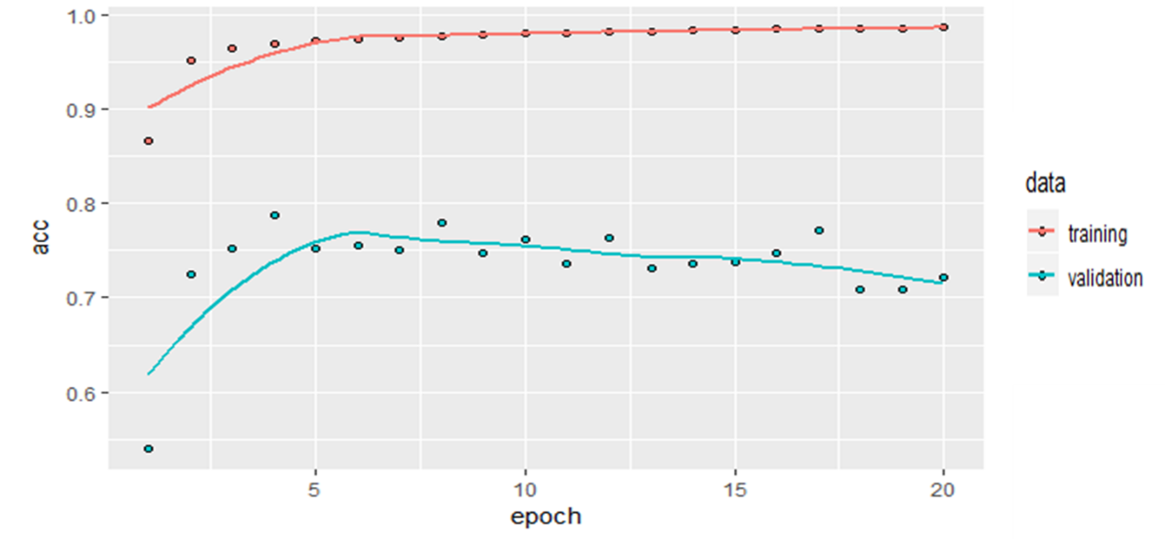
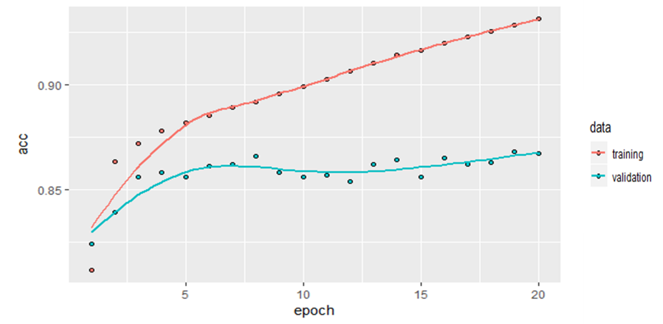
Sentiment classification of unstructured texts (Kim 2019, working paper)
Sentence Sentiment Classification Accuracy by Deep-learning Method (using Keras with TensorFlow in R)
An Accuracy Plot with All Training Data Sentences from Professor Reviews
An Accuracy Plot with All Training Data Sentences from Restaurant Reviews

Slide 9
Overview
Intro
Logistic Regression in Neural Network setting
(Artificial) Neural Network
Deep Learning

Slide 10
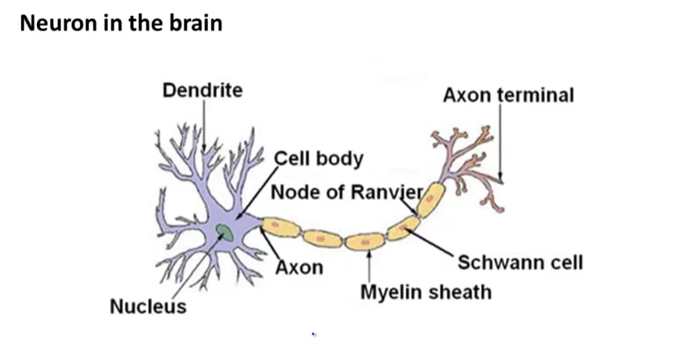
Real Human Neuron
We tried to create neural network system based on real human neuron.
Input wires
Signals
Output wires
Reference: Machine Learning in Coursera by Andrew Ng

Slide 11
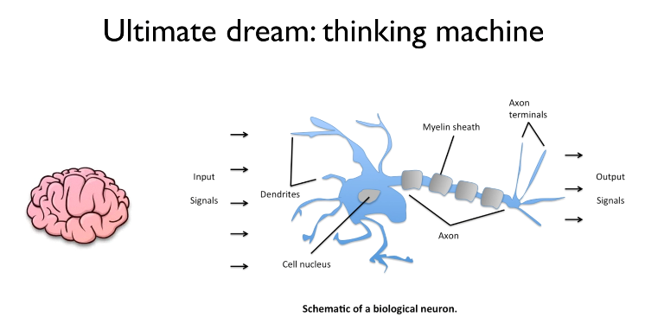
Background of Neural Networks: Mimicking Human Neuron
Popular in 80s and 90s but popularity decreased in 90s; but resurgence recently.
wx+b
https://www.youtube.com/watch?v=n7DNueHGkqE&index=19&list=PLlMkM4tgfjnLSOjrEJN31gZATbcj_MpUm

Slide 12
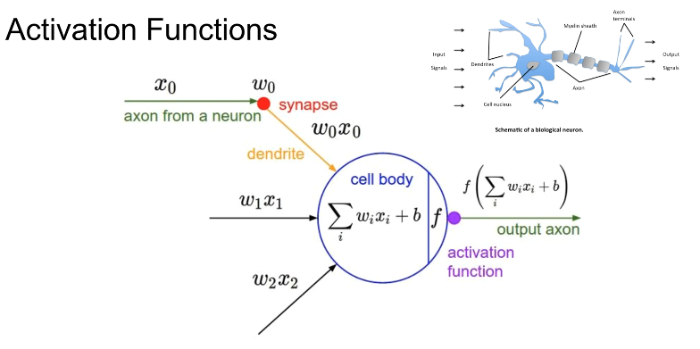
Activation functions like human neuron…
if f value is larger than certain criteria (e.g., Prob=0.5), output is 1 otherwise 0. (like logistic function)
W is weight in this model

Slide 13
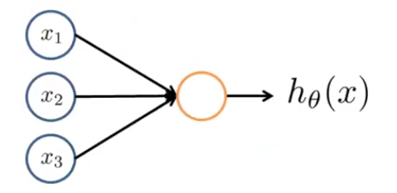
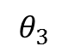
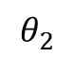
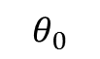
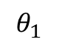
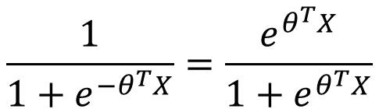
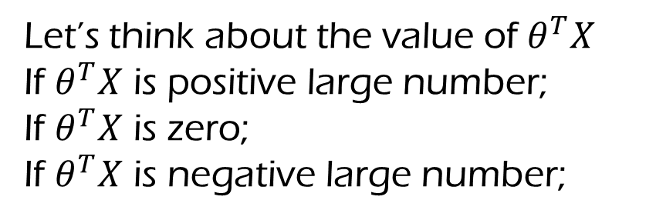
Let’s see Logistic Regression in Neural Network Setting
$$\frac{1}{1+e^{−θ^{T}X}}=\frac{e^{θ^{T}X}}{1+e^{θ^{T}X}}$$
x₀
$$θ_{0}$$
$$θ_{1}$$
$$θ_{2}$$
$$θ_{3}$$
Let’s think about the value of $θ^{T}X$
If $θ^{T}X$ is positive large number;
If $θ^{T}X$ is zero;
If $θ^{T}X$ is negative large number;
Notes:
Let’s think about the value of $θ^{T}X$
If $θ^{T}X$ is positive large number; h=1
If $θ^{T}X$ is zero; h=1/2
If $θ^{T}X$ is negative large number; h= 0

Slide 14
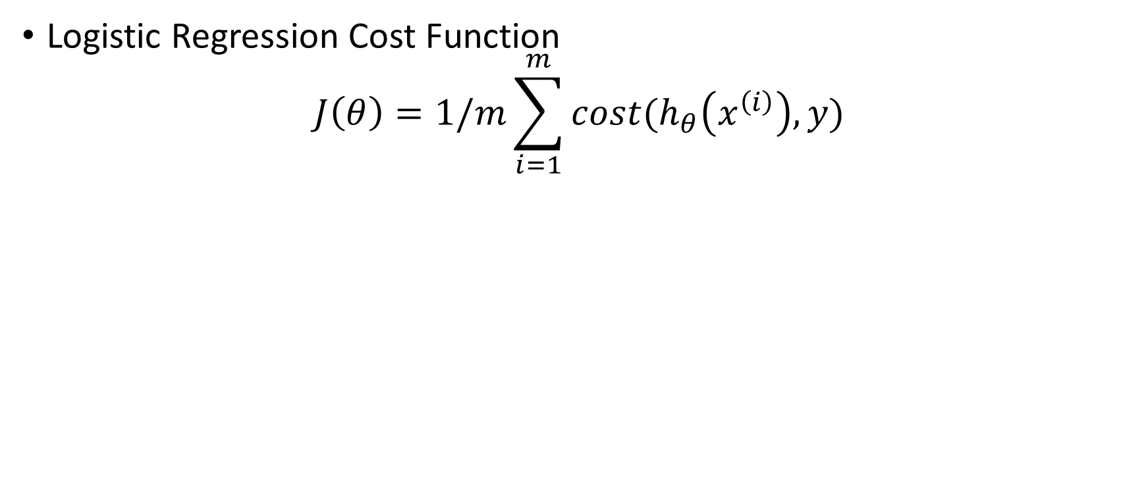
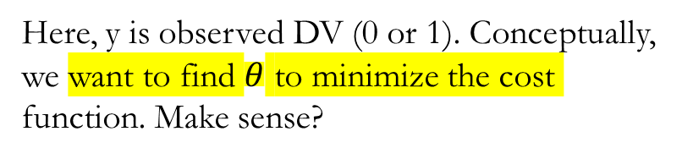
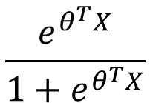
Logistic Regression in Neural Network Algorithm Setting
$$\frac{e^{θ^{T}X}}{1+e^{θ^{T}X}}$$
Logistic Regression Cost Function
$$J\left(θ\right)=1/m\sum_{i=1}^{m}{cost(h_{θ}\left(x^{\left(i\right)}\right),y)}$$
X₀
Bias unit; x₀=1
Here, y is observed DV (0 or 1). Conceptually, we want to find $θ$ to minimize the cost function. Make sense?
Input wires
output wires
Body of Neuron
Machine Learning in Coursera by Andrew Ng
Notes:
Cost = error
Y=observed

Slide 15
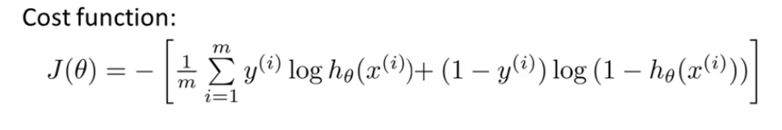
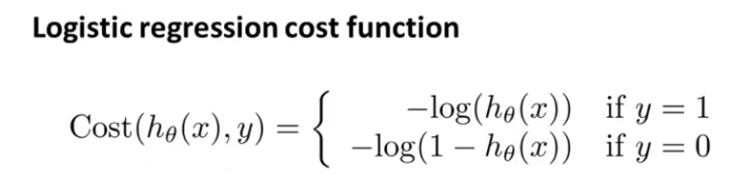
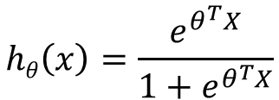
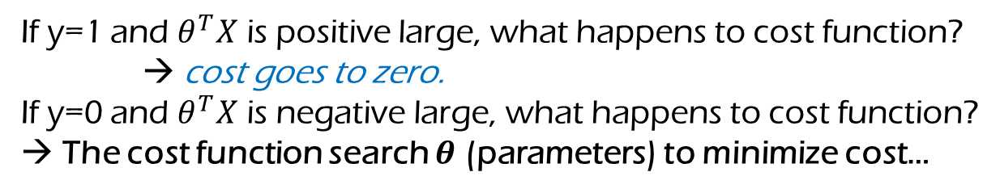
Rephrase the Cost Function of Logistic Regression as follows:
(+ Regularization Term)
$$hθ\left(x\right)=\frac{e^{θ^{T}X}}{1+e^{θ^{T}X}}$$
If y=1 and $θ^{T}X$ is positive large, what happens to cost function?
→ cost goes to zero.
If y=0 and $θ^{T}X$ is negative large, what happens to cost function?
→ The cost function search $θ$ (parameters) to minimize cost…
Similar Thinking as we learned in Logistic regression setting…
Machine Learning in Coursera by Andrew Ng
Notes:
ThetaX is positive large, hx goes to one. Then, cost of -log(hx) goes to 0 (cost can be minimized). Same like logistic regression but different operation in neural network setting…
We are handling log logistic… [0, Inf)

Slide 16
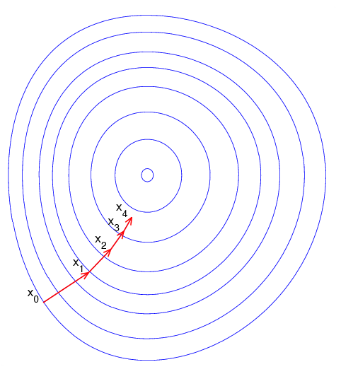
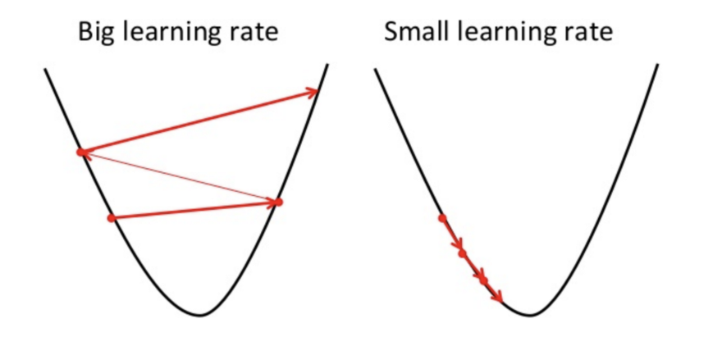
Gradient Descent to reduce the cost
Gradient Descent is the process of minimizing a function by following the gradients of the cost function. https://towardsdatascience.com/gradient-descent-in-a-nutshell-eaf8c18212f0
Notes:
In machine learning, we can use a technique that evaluates and updates the coefficients every iteration called stochastic gradient descent to minimize the error of a model on our training data.
The way this optimization algorithm works is that each training instance is shown to the model one at a time. The model makes a prediction for a training instance, the error is calculated and the model is updated in order to reduce the error for the next prediction. This process is repeated for a fixed number of iterations.
This procedure can be used to find the set of coefficients in a model that result in the smallest error for the model on the training data. Each iteration, the coefficients (b) in machine learning language are updated using the equation:

Slide 17
R Demonstration for Logistic Regression in Neural Network: Let’s use ‘logit_nnet’ function
Let’s run logistic regression in neural network with simulation data and then compare the estimated parameter W and true parameters.
Try step size of 0.01 with number of iterations of 10,000.
Now let’s run classic logistic regression code to compare estimated parameters.
Let’s check training data prediction accuracy between Logistic Regression in Neural Networks and Classic Logistic Regression
So, can we find similar results (estimated parameters) between neural network setting and logistic regression?

Slide 18
Binary Logistic Regression in Neural Network (Catalog Data)
Let’s run and practice both nnet.model and classic logistic regression with the Catalog Data… (using different number of iterations)
Both estimated parameters are similar?
What is prediction accuracy with nnet.model?
What is prediction accuracy with classic logistic regression?
Are there comparable?

Slide 19
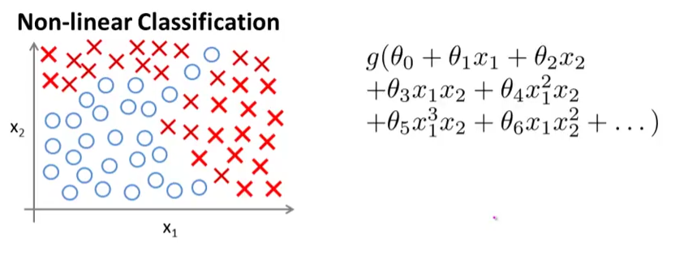
More in Neural Networks
Then, why neural Networks even though we have classic logistic regression?
Non-linear classification: adding square or cube term with multiple features → exponentially increase number of predictors in simple logistic regression.
Neural Networks can provide simple solution for this problem.
Reference: Machine Learning in Coursera by Andrew Ng;
I strongly recommend to watch his lecture in MOOC

Slide 20
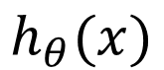
Simple Neural Network Model
Activation of unit i in layer j
X1
a1
X2
a2
$$h_{θ}(x)$$
X3
a3
Output layer
What is difference between Logistic Regression in Neural Network setting and the Neural Network Model here??
Input layer
Hidden layer

Slide 21
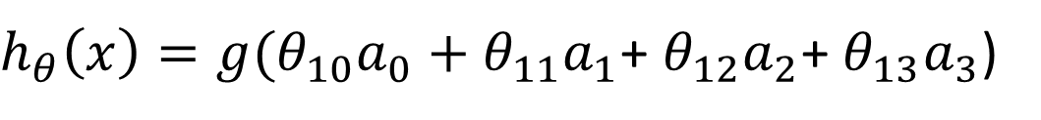
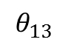
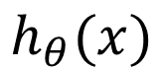
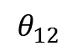
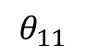
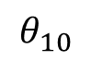
a0
$$θ_{10}$$
X1
a1
$$θ_{11}$$
X2
a2
$$θ_{12}$$
$$h_{θ}(x)$$
$$θ_{13}$$
Output layer
X3
a3
Input layer
Hidden layer
$h_{θ}\left(x\right)=g(θ_{10}a_{0}+$ $θ_{11}a_{1}$+ $θ_{12}a_{2}$+ $θ_{13}a_{3}$)
Doing similar thing like logistic regression with own a vector instead of X input data.

Slide 22
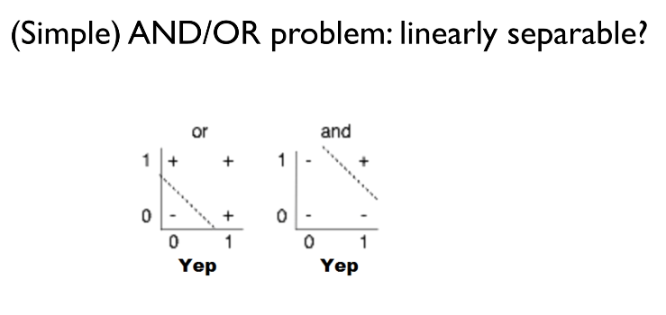
Origin of Neural Networks:
Can we classify ‘+’ and ‘-’ by using linear function?
AND
OR
x2
x1
X1
Well… Yes! This looks similar to Logistic Regression.
Y
X2
Sung Kim (HKUST) https://www.youtube.com/watch?v=n7DNueHGkqE&index=19&list=PLlMkM4tgfjnLSOjrEJN31gZATbcj_MpUm

Slide 23
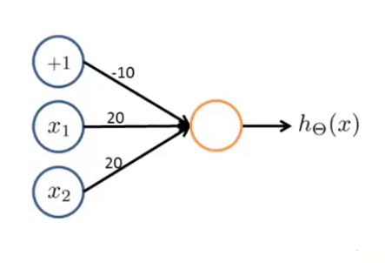
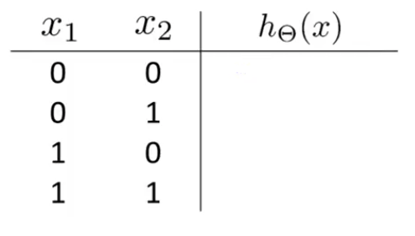

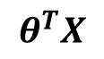
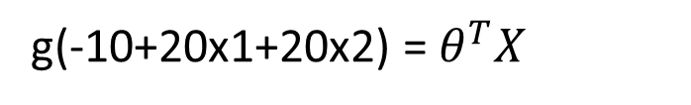
OR problem
Given the estimated Weights, we can solve the OR problem!
$$θ^{T}X$$
$$θ^{T}X$$
-10
10
10
30
g(-10+20x1+20x2) = $θ^{T}X$
Machine Learning in Coursera by Andrew Ng

Slide 24
How about this?
Logic for XOR problem?
1
?
0
Can XOR problem be solved using the following box machine?
0
1
x1
x2
y
?
Sung Kim (HKUST) https://www.youtube.com/watch?v=n7DNueHGkqE&index=19&list=PLlMkM4tgfjnLSOjrEJN31gZATbcj_MpUm

Slide 25
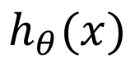
Add a hidden layer to solve XNOR problem!
Hidden layer
Y1
+1
Y*
$$h_{θ}(x)$$
X1
X2
Y2

Slide 26
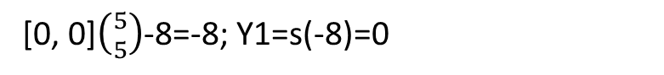
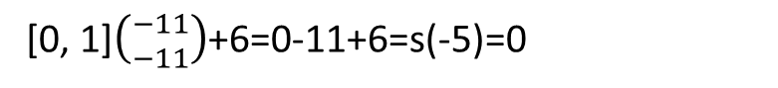
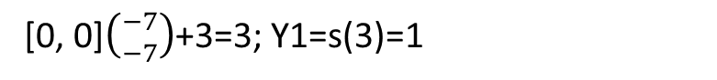
X1 nor X2 Problem
+1
+1
+1
3
6
-8
X1
-7
Y2
Y1
-11
Y*
X1
5
Y1
-7
-11
5
X2
Y2
X2
[0, 0]$\left({5 \atop 5}\right)$-8=-8; Y1=s(-8)=0
X1 | X2 | Y1 | Y2 | Y* | XNOR
0 | 0 | 0 | 1 | 0 | 0
0 | 1 |  |  |  | 1
1 | 0 |  |  |  | 1
1 | 1 |  |  |  | 0
[0, 0]$\left({−7 \atop −7}\right)$+3=3; Y1=s(3)=1
[0, 1]$\left({−11 \atop −11}\right)$+6=0-11+6=s(-5)=0
Y1
Y2
Please do other three cases for yourselves!
Notes:
The weights can be computed by Gradient Decent methods like in Logistic Regression Coefficient Estimation. But, in back propagation method, it can be computed based on (partial) derivatives…

Slide 27
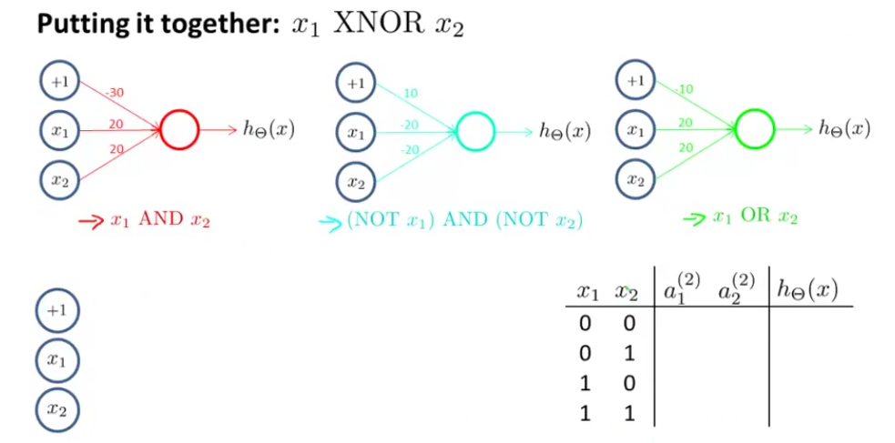
In-Class Practice Example.
Machine Learning in Coursera by Andrew Ng
Notes:
X1 x2 的参数与常数x0的关系对比

Slide 28
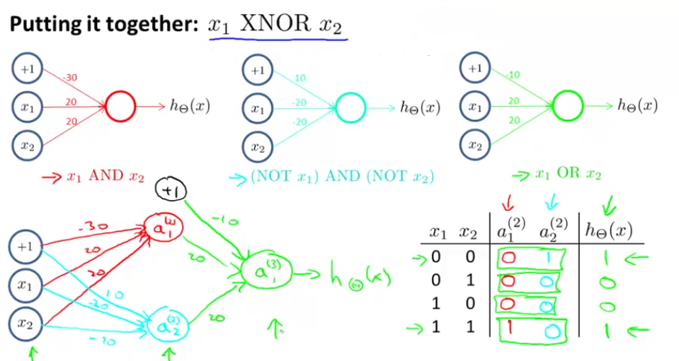
In-Class Practice Example.
Machine Learning in Coursera by Andrew Ng

Slide 29
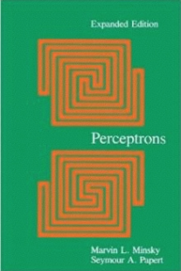
Perceptrons (1969) by Marvin Minsky (MIT AI Lab)
We need to use multilayer perceptrons (multilayer neural nets)
No one on earth had found a visible way to train multilayer perceptrons good enough to learn such simple functions (e.g., XOR)
Sung Kim (HKUST) https://www.youtube.com/watch?v=n7DNueHGkqE&index=19&list=PLlMkM4tgfjnLSOjrEJN31gZATbcj_MpUm

Slide 30
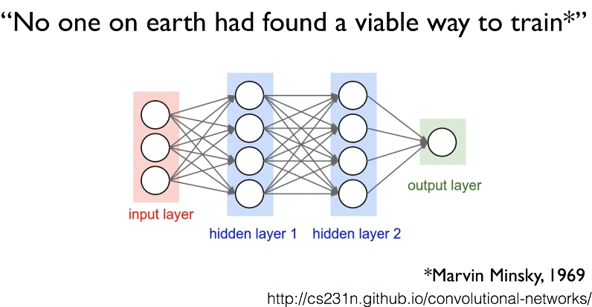
Sad moment for neural network development

Slide 31
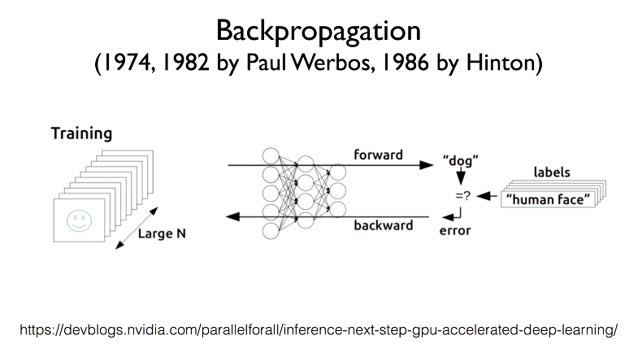
Recently better solution using various methods has been found…

Slide 32
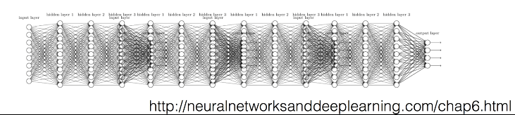
Challenges for Backpropagation of Neural Networks
Backpropagation just did not work well for normal neural nets with many layers –
ReLU (Rectified Linear Units) instead of sigmoid – helps derivatives in the Backpropagation)
Faster Optimizers to find Weights (e.g. Stochastic Gradient Decent)
Variable Selection (dropout) to reduce Overfitting Issue

Slide 33
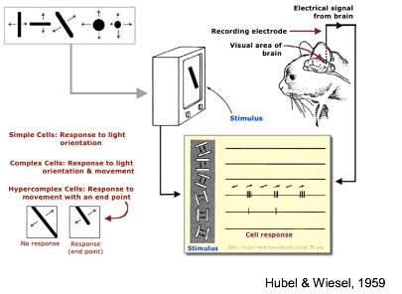
Convolutional Neural Networks
Old idea but recently very popular!
Developed by mimicking how cat perceive and process the TV screen image…

Slide 34
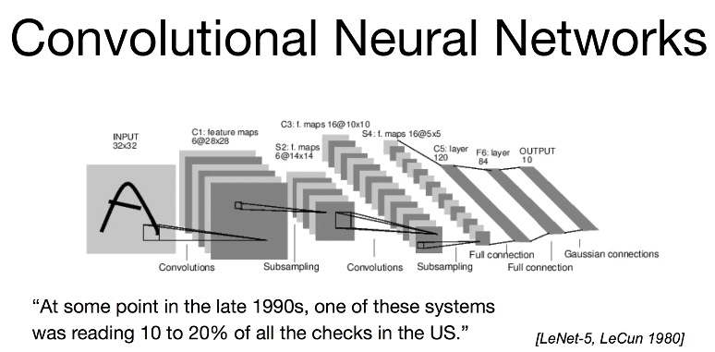

Slide 35
Practice the Neural Network with R
We can try this using R Neural Network package ‘neuralnet’
We can try this using Catalog sample dataset.
Let’s compare the prediction results between the binary logistic regression and neuralnet.
For more information, see http://www.michaeljgrogan.com/neural-network-modelling-neuralnet-r/

